Slide 1
Classroom Collaboration Analytics: Designing and Building Automated Systems for Collaboration Monitoring in Classroom Settings
Pankaj Chejara
pankajch@tlu.ee
Researcher
Tallinn University
Tallinn, Estonia
image: Freepik.com

Slide 2
AGENDA
Introduction
Modeling collaboration
Generalizability
CoTrack
Challenges/Future directions
Conclusion
Notes:
Add that some of the opponent’s comments which were not describe in the response document (though updated in thesis) are tackled in this presentation.

Slide 3
INTRODUCTION
COLLABORATION
Collaboration is a complex construct (Rummel et al., 2011).
image: Freepik.com

Slide 4
INTRODUCTION
COLLABORATION
Collaboration is a complex construct (Rummel et al., 2011).
Argumentation
Individual task orientation
Mutual understanding
Collaboration flow
Cooperative orientation
Collaboration Quality
Knolwledge exchange
Structuring problem-solving
image: Freepik.com

Slide 5
INTRODUCTION
COLLABORATION
Collaboration is a complex construct (Rummel et al., 2011).
Argumentation
Individual task orientation
Mutual understanding
Collaboration flow
Cooperative orientation
Collaboration Quality
Knolwledge exchange
Structuring problem-solving
image: Freepik.com
Difficult for teachers to monitor and detect problems (Chounta & Avouris, 2016)

Slide 6
INTRODUCTION
COLLABORATION
Collaboration is a complex construct (Rummel et al., 2011).
Argumentation
Individual task orientation
Mutual understanding
Collaboration flow
Cooperative orientation
Collaboration Quality
Knolwledge exchange
Structuring problem-solving
Difficult for teachers to monitor and detect problems (Chounta & Avouris, 2016)
image: Freepik.com

Slide 7
INTRODUCTION
MULTIMODAL LEARNING ANALYTICS
Uses sensors along with log data
(Ochoa et al., 2017).
Captures multimodality of students’ interactions.
image: Freepik.com

Slide 8
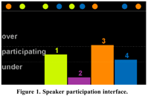
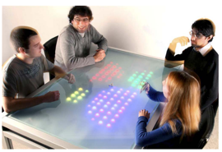
INTRODUCTION
MULTIMODAL LEARNING ANALYTICS
Speaking time
(collaboration quality)
Collaboration quality
(Martinez-Maldonado et al., 2011)
(Martinez-Maldonado et al., 2011)
Speaking participation
(DiMicco et al., 2004)
Distance between hands
(Performance)
Rapport
LED matrix display
(Bachour et al., 2010)
(Spikol et al., 2018)
(Lubold et al., 2011)
Visualization
Pattern
Modeling

Slide 9
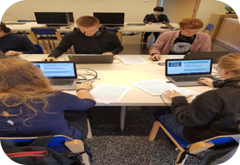
MODELING COLLABORATION
Annotation
Data collection
Feature extraction
Feature merging
ML model development
ML model Evaluation

Slide 10
Data collection
Feature extraction
Feature merging
ML model development
ML model Evaluation
1
iMotions Lab
Commercialized
2
Multimodal Learning Hub
Multimodal data collection systems
Schneider et al., 2018
3
Social Signal Framework
Wagner et al., 2013
4
Lab Streaming Layer
Kothe et al., 2014
5
EZ-MMLA toolkit
Schneider et al., 2022
6
CoTrack
Chejara et al., 2024

Slide 11
Data collection
Feature extraction
Feature merging
ML model development
ML model Evaluation
Voice activity detection (VAD, py-webrtcvad)
Speaking time
Turn-taking
Acoustic feature extraction
(OpenSmile tool)
Pitch
Feature extraction
Energy
Audio data
Speech-to-Text
(Google Speech-to-Text)
Speech data
Facial exrepssions
(OpenFace, Py-Feat )
Facial action units
Emotions
Video data
Body movement
(OpenPose)
Head movement
Hand movement

Slide 12
Data collection
Feature extraction
Feature merging
ML model development
ML model Evaluation
Facial expressions (25 data points per seconds)
d
Summary stats
(10 seconds)
Feature merging
Voice activity(5 data points per seconds)
Group level features
Group
Facial expressions (25 data points per seconds)
Summary stats
(10 seconds)
Voice activity(5 data points per seconds)

Slide 13
Annotation
Data collection
Feature extraction
Feature merging
ML model development
ML model Evaluation
Annotation
Expert evaluation
Artifact assessment
Self-reported survey

Slide 14
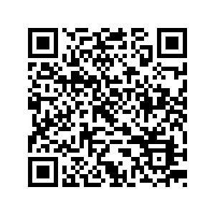
Annotation
Data collection
Feature extraction
Feature merging
ML model development
ML model Evaluation
Annotation
Expert evaluation
Artifact assessment
Self-reported survey
Rating handbook
(Rummel et al., 2011)
Notes:
Add QR code to rating scheme

Slide 15
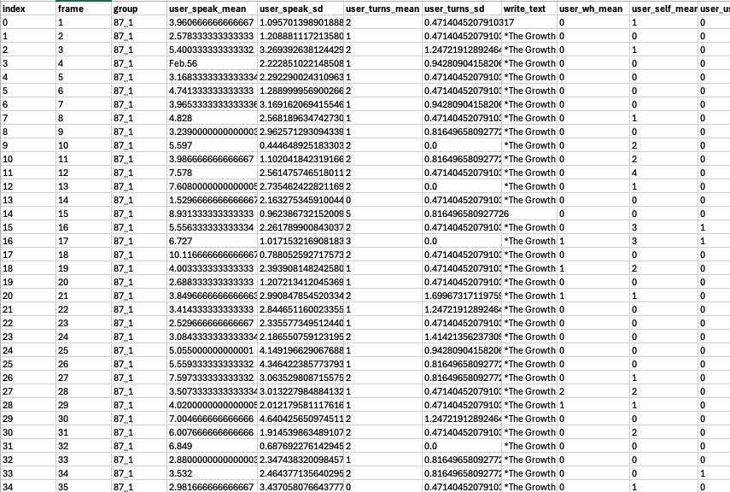
Data collection
Feature extraction
Feature merging
ML model development
ML model Evaluation
ML model development
Dataset
Notes:
Add QR code to rating scheme

Slide 16
Data collection
Feature extraction
Feature merging
ML model development
ML model Evaluation
Dataset
ML model development
Training
Testing
ML model development
ML model
Notes:
Add QR code to rating scheme

Slide 17
Data collection
Feature extraction
Feature merging
ML model development
ML model Evaluation
Dataset
ML model Evaluation
Training
Testing
ML model
Notes:
Add QR code to rating scheme

Slide 18
WHAT NEXT?
Would our model work well in authentic classroom settings?
Collaboration quality model
Transitioning from research to practice
NOISE ISSUE
VARYING CONTEXT

Slide 19
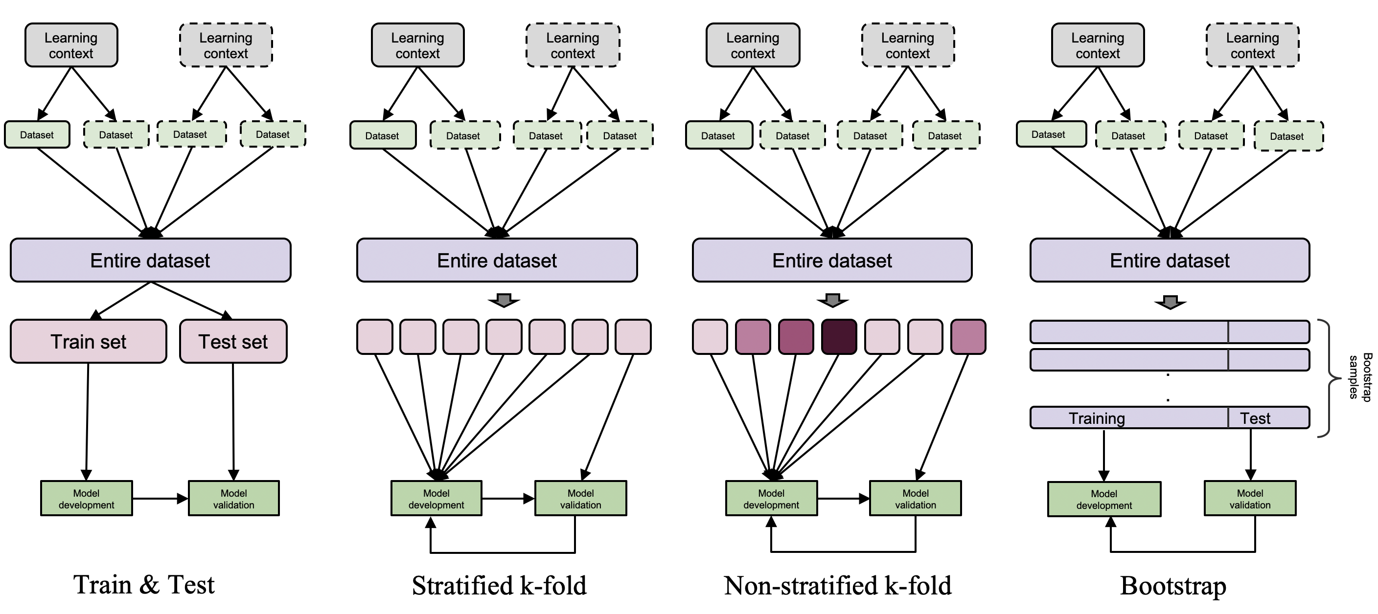
GENERALIZABILITY
1
Ability of machine learning models to perform well on unseen data (Raschka, 2018).
1
2
Model Evaluation Methods

Slide 20
GENERALIZABILITY
1
Ability of machine learning models to perform well on unseen data (Raschka, 2018).
1
2
Model Evaluation Methods

Slide 21
GENERALIZABILITY
1
Ability of machine learning models to perform well on unseen data (Raschka, 2018).
1
2
Model Evaluation Methods

Slide 22
GENERALIZABILITY
1
Ability of machine learning models to perform well on unseen data (Raschka, 2018).
Lack of systematization for generalizability evaluation & reporting
1
Do not consider
educational nature of MMLA
2
Model Evaluation Methods

Slide 23
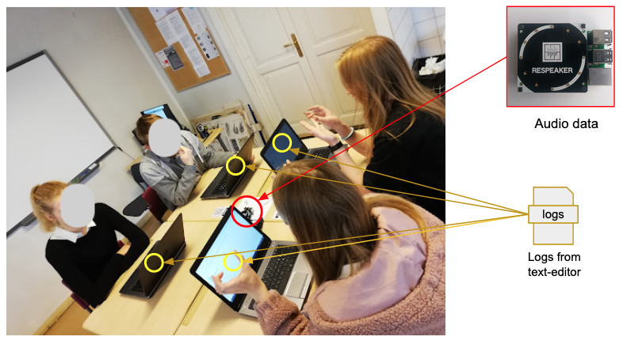
EXAMPLE
1
Features (30 sec)
Speaking time
number of char added
number of char deleted
Group | 2
Group-size | 4
Duration | 30 mins
Instances | 121
Human
ML model
Chance
Chejara, P., Prieto, L. P., Ruiz-Calleja, A., Rodríguez-Triana, M. J., Shankar, S. K., & Kasepalu, R. (2020). Quantifying collaboration quality in face-to-face classroom settings using MMLA. In International Conference on Collaboration Technologies and Social Computing (CollabTech) (pp. 159-166). Springer, Cham. https://doi.org/10.1007/978-3-030-58157-2_11

Slide 24
How to systematically assess and report generalizability in MMLA?

Slide 25
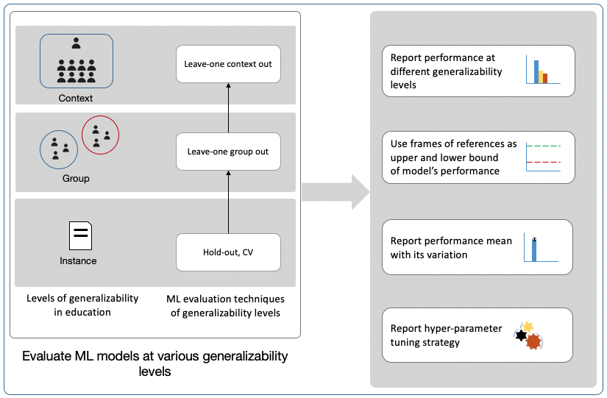
EFAR-MMLA
GENERALIZABILITY EVALUATION FRAMEWORK
Chejara, P., Prieto, L. P., Ruiz-Calleja, A., Rodríguez-Triana, M. J., Shankar, S. K., & Kasepalu, R. (2021). EFAR-MMLA: An evaluation framework to assess and report generalizability of machine learning models in MMLA. Sensors (21), 2863. https://doi.org/10.3390/s21082863

Slide 26
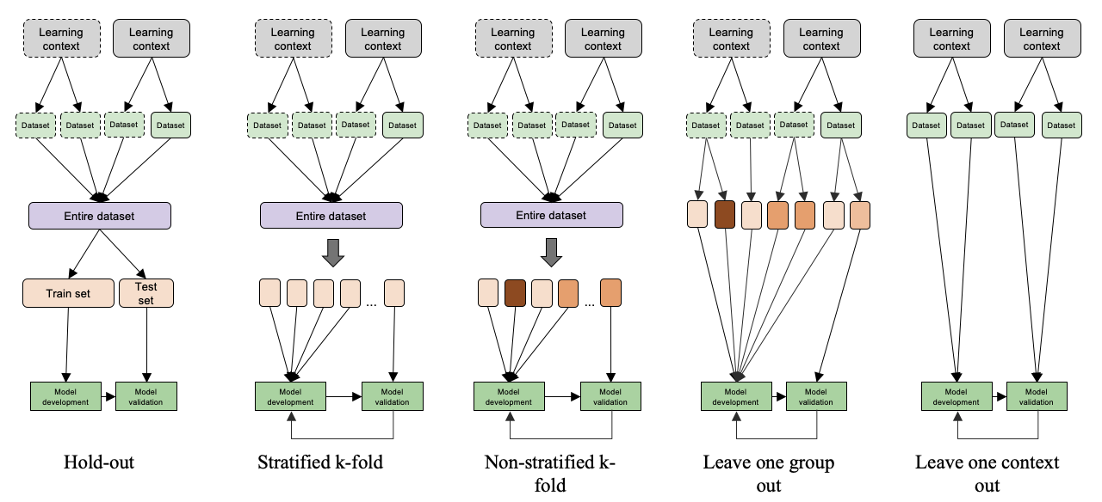
EFAR-MMLA
GENERALIZABILITY EVALUATION FRAMEWORK

Slide 27
EFAR-MMLA
GENERALIZABILITY EVALUATION FRAMEWORK

Slide 28
EFAR-MMLA
GENERALIZABILITY EVALUATION FRAMEWORK

Slide 29
EFAR-MMLA
GENERALIZABILITY EVALUATION FRAMEWORK
1
Assessment of generalizability relavant to MMLA
2
Bias identification

Slide 30
How well an automated collaboration estimation models perform across different contexts varying on subject, classroom, students, task activity and school?

Slide 31
CONTEXT GENERALIZABILITY
Different tasks
ML model
Different task types
Different schools

Slide 32
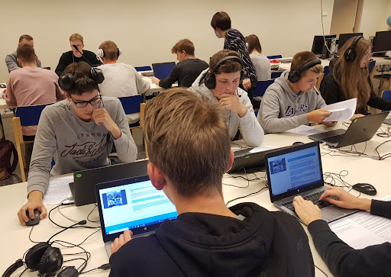
CONTEXT GENERALIZABILITY
Feature extraction & merging
Supervised machine learning
Estonian Vocational school
Chejara, P., Kasepalu, R., Prieto, L., P., Rodríguez-Triana, M. J., Ruiz-Calleja, A., & Schneider, B. (2023). How well do collaboration quality estimation models generalize across authentic school contexts. British Journal of Educational Technology, 00, 1–23. https://doi.org/10.1111/bjet.13402

Slide 33
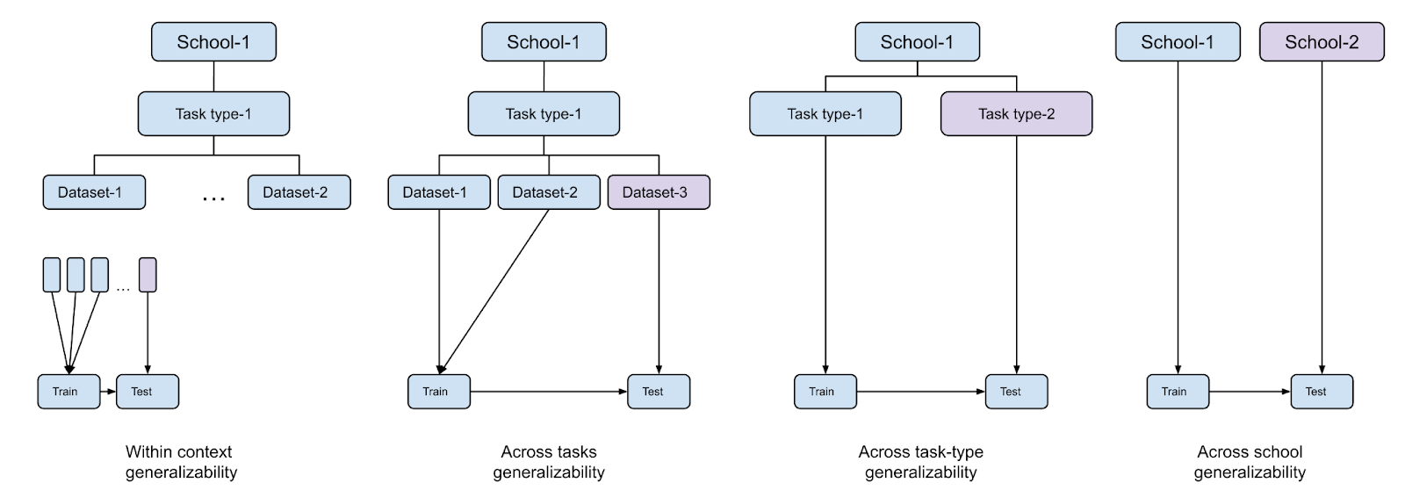
EVALUATION

Slide 34
EVALUATION

Slide 35
EVALUATION

Slide 36
EVALUATION

Slide 37
RESULTS
GENERALIZABILITY ACROSS CONTEXTS
HUMAN PERFORMANCE
87 %
MODEL PERFORMANCE
82 %

Slide 38
RESULTS
GENERALIZABILITY ACROSS CONTEXTS
HUMAN PERFORMANCE
87 %
MODEL PERFORMANCE
82 %
Within context
68 %
Across different tasks (group discussion)
59 %
Across different tasks types
61 %
Across schools (group discussion tasks)

Slide 39
RESULTS
GENERALIZABILITY ACROSS CONTEXTS
HUMAN PERFORMANCE
87 %
MODEL PERFORMANCE
82 %
Within context
49 %
Across different tasks (collaborative writing)

Slide 40
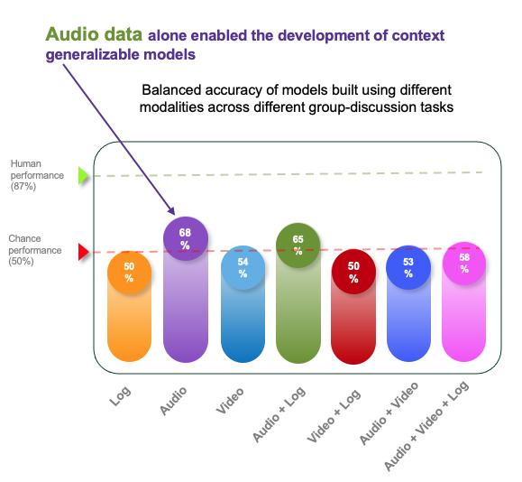
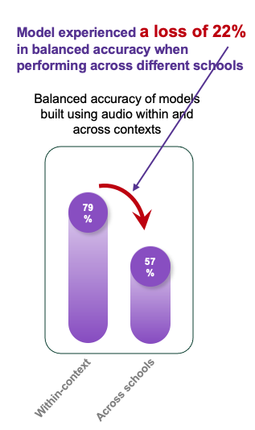
RESULTS
DATA IMPORTANCE

Slide 41
How to collect multimodal data from classrooms?

Slide 42
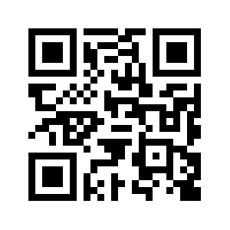
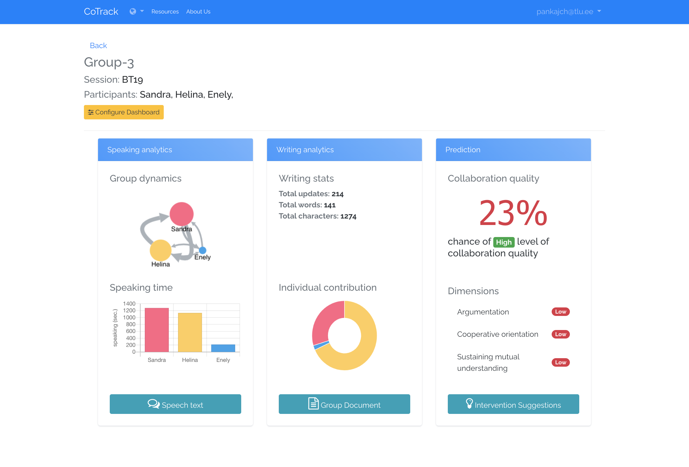
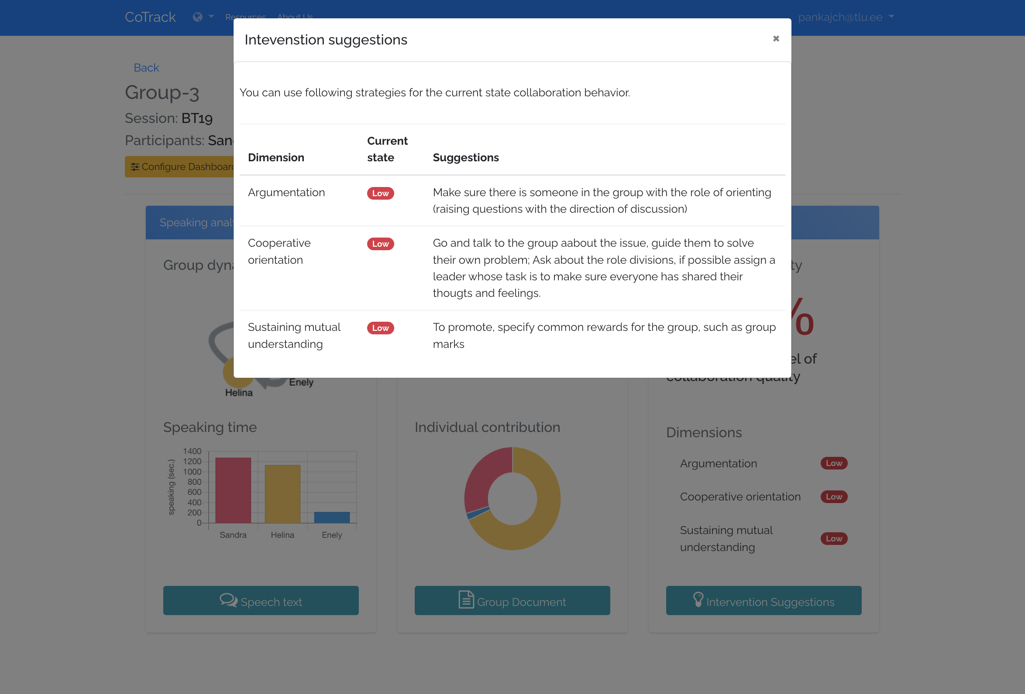
Tool Demo
https://www.cotrack.website
6
600
58
Students
Researchers
Teachers

Slide 43
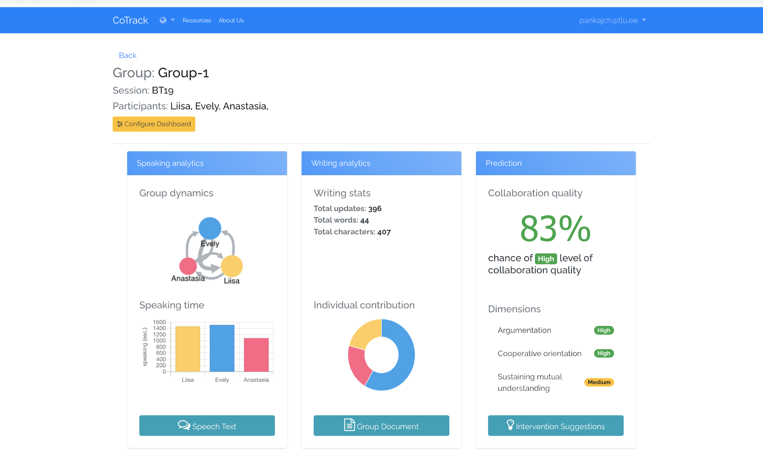
Group VIEW
Configure the dashboard.
Predicted chances of high collaboration quality. Higher is better.
Group dynamics in terms of who is talking to whom.
Predicted level of three dimensions of collaboration quality.
Speaking time of each group member.
It shows how much everyone in the group contributed to written text document.
To see the word cloud of group’s conversation.
To see group's written document.
To see suggestions on interventions.

Slide 44
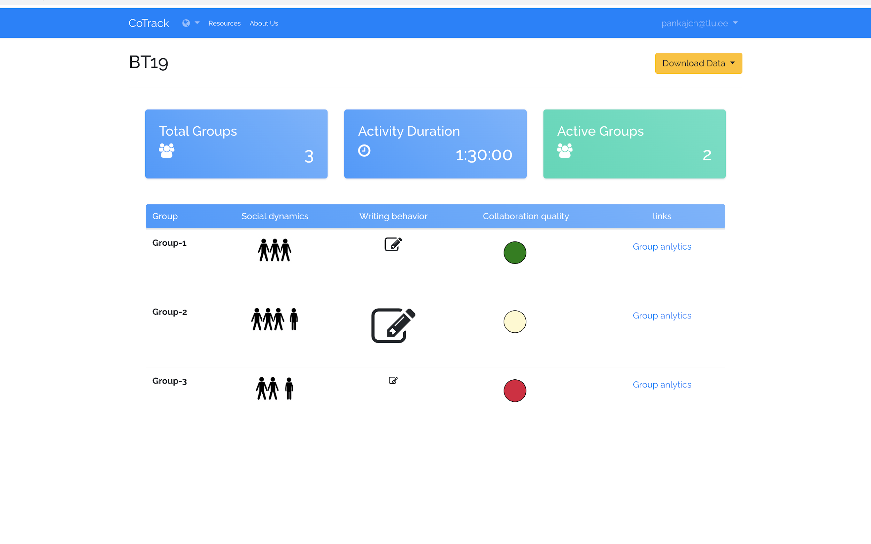
CLASSROOM VIEW
Basic details
Showing how equally group participants are speaking (in this example, only three students are talking to each other more often)
It shows the size of text each group has produced in comparison with other groups.
This traffic system shows the predicted collaboration quality level of the group. (Green: High, Yellow: Medium, Red: Low)
Chejara, P., Kasepalu, R., Prieto, L., P., Rodríguez-Triana, M. J., & Ruiz-Calleja, A. (2024). Bringing collaboration analytics using multimodal data to the masses: Evaluation and design guidelines for developing a mmla system for research and teaching practices in CSCL. In the 14th International Learning Analytics and Knowledge Conference (LAK24). ACM. https://doi.org/10.1145/3636555.3636877

Slide 45
How to build across context generalizable ML models for collaboration quality estimation?

Slide 46
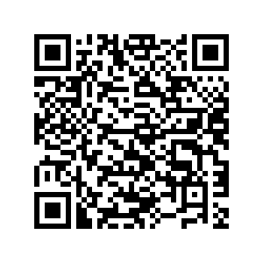
GUIDELINES
1
Use 60 seconds time window for data segmentation for modeling collaboration quality using multimodal data
2
Use Random Forest for building robust ML models for collaboration quality
3
Use of contextual data to build context generalizable models for estimating collaboration quality
4
Use of audio data alone may enable development of across-context generalizable collaboration quality estimation models
Thesis link

Slide 47
FUTURE DIRECTIONS
1
Small dataset size
2
Investigation using cross-modal features
3
Impact of choosing different choices of ML modeling step on generalizability
4
Privacy-preserving approaches for MMLA
5
Teacher’s perception and response to AI-enabled systems

Slide 48
“
Your reasoning of WHY you do WHAT you do is more critical than WHAT you do.
Anonymous
Thank you

Slide 49
References
﻿Chounta, I. A., & Avouris, N. (2016). Towards the real-time evaluation of collaborative activities: Integration of an automatic rater of collaboration quality in the classroom from the
teacher’s perspective. Education and Information Technologies, 21(4), 815–835. https://doi.org/10.1007/s10639-014-9355-3
2. Rummel, N., Deiglmayr, A., Spada, H., Kahrimanis, G., & Avouris, N. (2011). Analyzing Interactions in CSCL. Analyzing Interactions in CSCL, 367–390. https://doi.org/10.1007/978-1-4419-7710-6
3. DiMicco, J. M., Pandolfo, A., & Bender, W. (2004). Influencing group participation with a shared display. Proceedings of the 2004 ACM Conference on Computer Supported
Cooperative Work - CSCW ’04, 614. https://doi.org/10.1145/1031607.1031713
4. Bachour, K., Kaplan, F., & Dillenbourg, P. (2010). An interactive table for supporting participation balance in face-to-face collaborative learning. IEEE Transactions on Learning Technologies, 3(3), 203–213. https://doi.org/10.1109/TLT.2010.18
5. Lubold, N., & Pon-Barry, H. (2014). Acoustic-Prosodic Entrainment and Rapport in Collaborative Learning Dialogues. Proceedings of the 2014 ACM Workshop on Multimodal Learning Analytics Workshop and Grand Challenge - MLA ’14, 5–12. https://doi.org/10.1145/2666633.2666635
5. Ochoa, X., & Worsley, M. (2016). Augmenting Learning Analytics with Multimodal Sensory Data. Journal of Learning Analytics, 3(2), 213–219. https://doi.org/10.18608/jla.2016.32.10
4. Raschka, S. Model Evaluation, Model Selection, and Algorithm Selection in Machine Learning. arXiv 2018, arXiv:1811.12808.
6. Martínez-maldonado, R. (2011). Modelling and Identifying Collaborative Situations in a Collocated Multi- display Groupware Setting. Lecture Notes in Computer Science (Including Subseries Lecture Notes in Artificial Intelligence and Lecture Notes in Bioinformatics), 6738(June), 39–46. https://doi.org/10.1007/978-3-642-21869-9
7. Spikol, D., Ruffaldi, E., Dabisias, G., & Cukurova, M. (2018). Supervised machine learning in multimodal learning analytics for estimating success in project-based learning.
Journal of Computer Assisted Learning, 34(4), 366–377. https://doi.org/10.1111/jcal.12263
8. Drachsler, H., & Greller, W. (2016, April). Privacy and analytics: it's a DELICATE issue a checklist for trusted learning analytics. In Proceedings of the sixth international conference on learning analytics & knowledge (pp. 89-98).

Slide 50
Building and assessing automated models for estimating collaboration quality (and its dimensions) of small groups in authentic classroom settings
Methodology:
Engineering Methods (Basili, 1993)
Informational
Proposal
Analytical
Evaluative
Repeat
Contributions:
CoTrack
Lit-review of multimodal data collection tools
Prototype design
Tool development
Users evaluation
Multimodal data collection tool
EFAR-MMLA
An Evaluation Framework for Assessing and Reporting generalizability of ML models in MMLA
1
Lit-review on generalizability evaluation
Framework proposal
Analysis using audio-log datasets
Evaluation using case-study
Sensors’21 (1.1)
G-Met
1
Lit-review on automated collaboration estimation
Approach to understand collaboration from multimodal data
Analysis using an observation-based multimodal dataset
Statistical evaluation
Methodology for building Generalizable ML model for collaboration quality and its dimensions
2
Extended Lit-review
Group-level feature aggregation
Analysis using multimodal dataset (audio and log)
Within context evaluation
EC-TEL’19 (3.1)
CollabTech’20 (3.1)
3
Lit-review on temporal window sizes and model building pipeline
Methodology for finding window size and building models
Analysis using multimodal dataset (audio and log)
Across contexts evaluation (single school)
LAK’23 (3.1)
LAK’23 (3.1)
Co-Models
Noise impact study design
Buidling automated models for CQ (audio and log)
Across contexts evaluation (single school)
1
Lit-review on noise impact on model’s performance
Collaboration quality indicators and machine learning models for authentic classroom settings
2
Lit-review on collaboration indicators in classroom
Proposal of an un-supervised learning-based method
Analyzing relationship between video and log data, and CQ
Statistical evalution
EC-TEL’23 (3.1)
# BJET’23 (1.1)
3
Extended lit-review on generalizability evaluation
Across school evalution study design
Buidling automated models for CQ (audio, video and log)
Across schools generalizability evalution
# JLA’23 (1.1)
Dark-colored boxes: publications; #: Submitted

Slide 51
CLASSROOM COLLABORATION ANALYTICS: DESIGNING AND BUILDING AUTOMATED SYSTEMS FOR MONITORING COLLABORATION IN CLASSROOM
Research Gaps
Research Questions
Research Objectives
Data
Analysis
Publications
RG #1: There is a lack of systematization for the evaluation of automated machine learning models in MMLA and specifically MMLA for collaboration.
RQ #1: How to systematically assess and report generalizability of automated estimation models of collaboration quality and its dimensions in small groups in class?
OB #1. To systematically assess and report generalizability of machine learning-based MMLA solutions of collaboration quality.
Supervised machine learning
III
Audio
Log data
RQ #2: How to build across-context generalizable automated estimation models of collaboration quality and its dimensions in small groups in classroom collaborative learning?
OB #2. To identify machine learning pipeline configurations that enable the building of more generalizable collaboration quality estimation models.
Dimensionality reduction
I
RG #2. There is a lack of knowledge over building generalizable collaboration quality estimation models for classroom settings.
II
Supervised machine learning
IV
Audio
Log data
V
Statistical analysis
OB #3. To investigate the impact of attribute noise on the performance of collaboration quality models in authentic settings.
Supervised machine learning
IX
RQ #3: How well do automated estimation models for collaboration quality and its dimensions perform across contexts (e.g., task contexts, task type contexts, school contexts) in authentic classroom settings?
RG #3. The field lacks knowledge on to what extent automated collaboration models can generalize in classroom settings.
Audio
Log data
OB #4. To investigate generalizability of automated estimation models of collaboration quality at different levels (across different tasks, task-types, schools).
Unsupervised machine learning
VII
VIII
Audio
Log data
Supervised machine learning
Publication category 1.1
Statistical analysis
Publication category 3.1
Video data

Slide 52
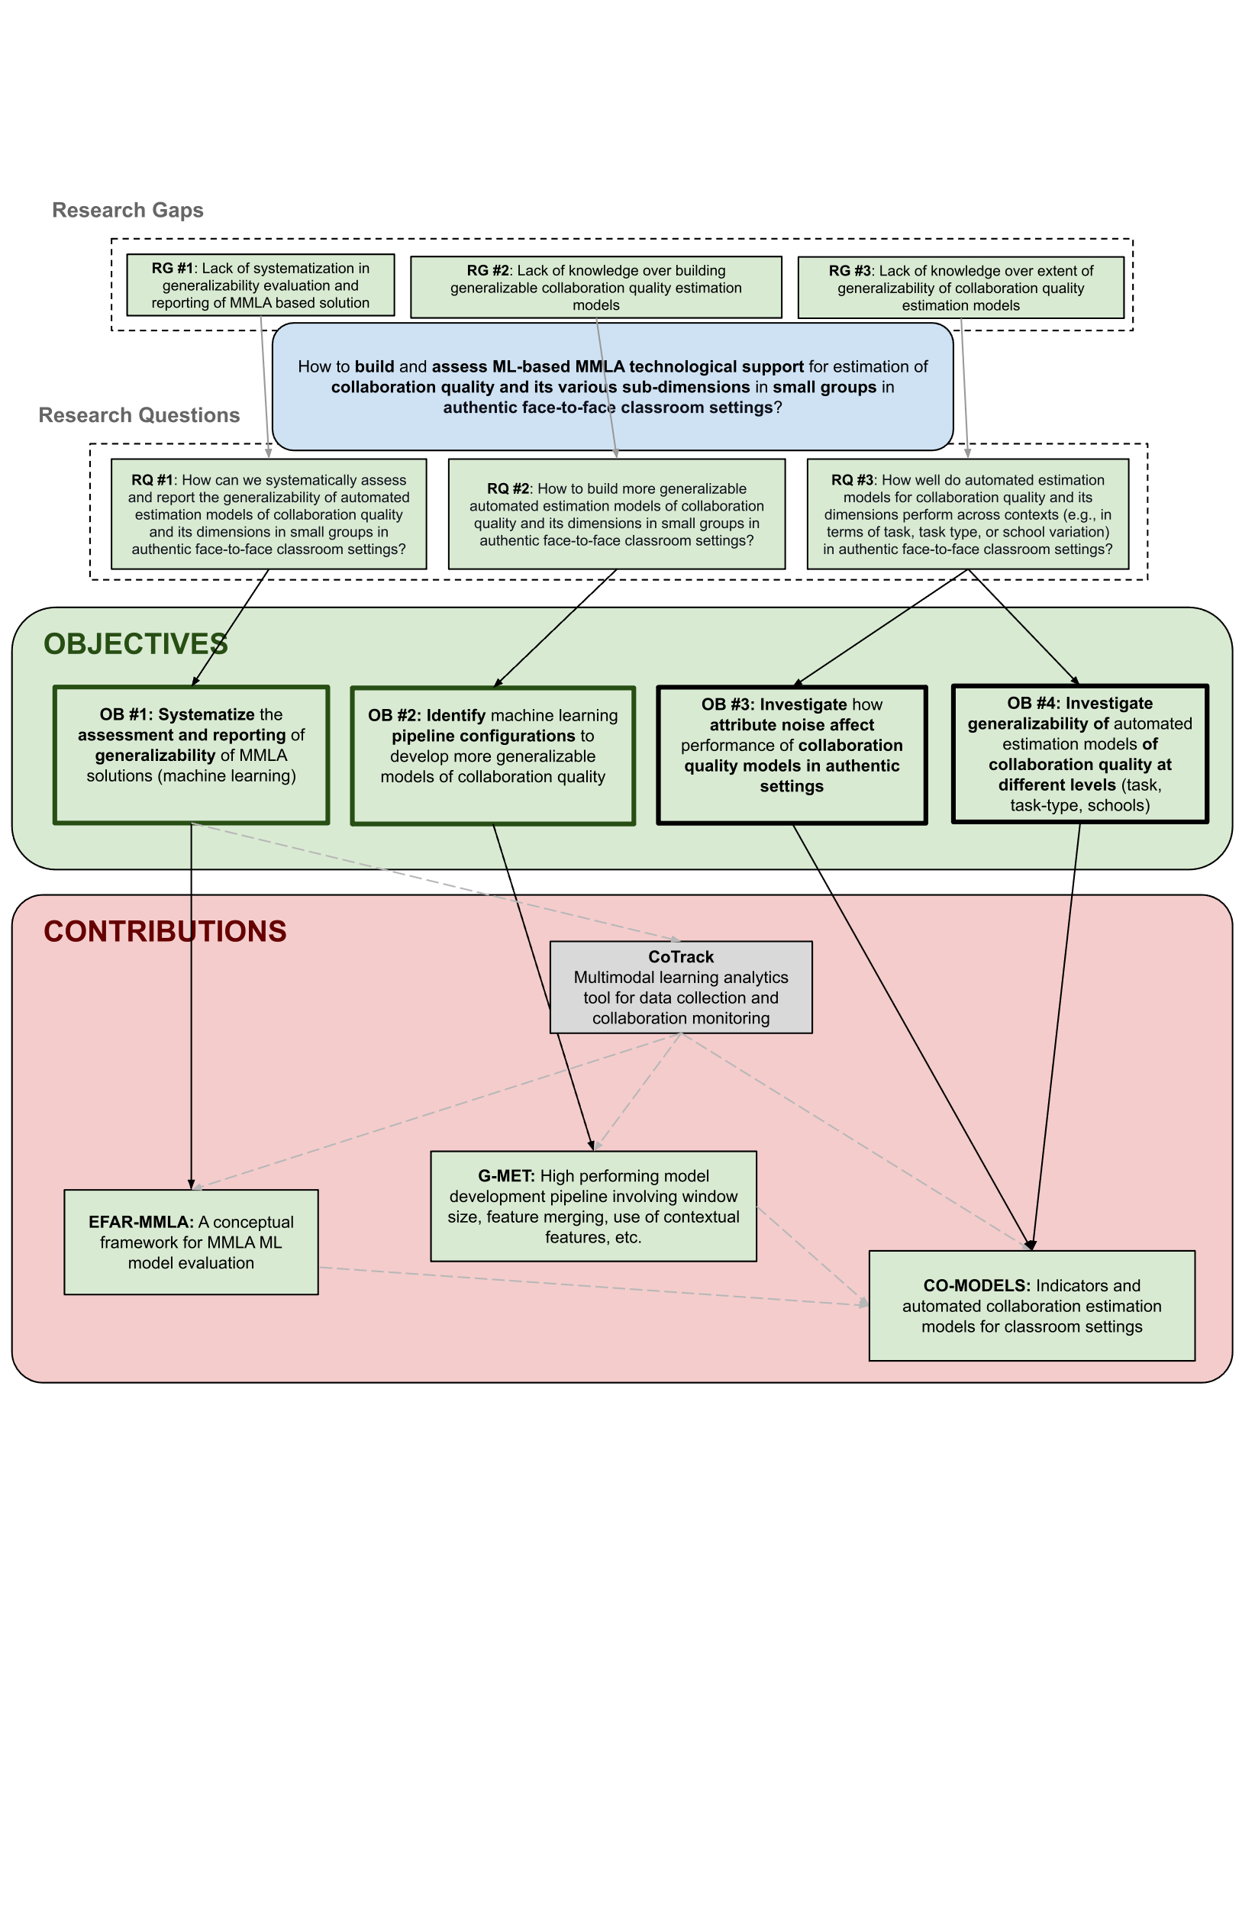

Slide 53
Timeline
Year-1
Year-2
Year-3
Year-4
Year-5
2018
2019
2020
2021
2022
2023
Framework
Methodology
Building

Slide 54
Interview & Development
Human-Centered Design
&
Development
8 In-service teachers
2019
Development & Feedback
50 In-service teachers
2021
Refinement
ML model development
2023
4
Notes:
Web version of CoTrack (why Covid, plus the first prototype required a technical person to configure everything and was not easy for non-extert MMLA users

Slide 55
CLASSROOM COLLABORATION ANALYTICS: DESIGNING AND BUILDING AUTOMATED SYSTEMS FOR MONITORING COLLABORATION IN CLASSROOM
Research Gaps
Research Questions
Research Objectives
Data
Analysis
Publications
RG #1: There is a lack of systematization for the evaluation of automated machine learning models in MMLA and specifically MMLA for collaboration.
RQ #1: How to systematically assess and report generalizability of automated estimation models of collaboration quality and its dimensions in small groups in class?
OB #1. To systematically assess and report generalizability of machine learning-based MMLA solutions of collaboration quality.
Supervised machine learning
III
Audio
Log data
RQ #2: How to build more generalizable automated estimation models of collaboration quality and its dimensions in small groups in classroom collaborative learning?
OB #2. To identify machine learning pipeline configurations that enable the building of more generalizable collaboration quality estimation models.
Dimensionality reduction
I
RG #2. There is a lack of knowledge over building generalizable collaboration quality estimation models for classroom settings.
II
Supervised machine learning
IV
Audio
Log data
V
Statistical analysis
OB #3. To investigate the impact of attribute noise on the performance of collaboration quality models in authentic settings.
Supervised machine learning
IX
RQ #3: How well do automated estimation models for collaboration quality and its dimensions perform across contexts (e.g., task contexts, task type contexts, school contexts) in authentic classroom settings?
RG #3. The field lacks knowledge on to what extent automated collaboration models can generalize in classroom settings.
Audio
Log data
OB #4. To investigate generalizability of automated estimation models of collaboration quality at different levels (across different tasks, task-types, schools).
Unsupervised machine learning
VII
VIII
Audio
Log data
Supervised machine learning
Publication category 1.1
Statistical analysis
Publication category 3.1
Video data

Slide 56
https://www.digitaleducationcouncil.com/post/eu-ai-act-what-it-means-for-universities

Slide 57
ETHICAL CONCERNS
External
E
D
Determination
Regulation for external service providers
Why do you want to apply learning analytics?
DELICATE FRAMEWORK
( Drachsler & Greller, 2016)
Voluntary participation
Technical
T
E
Explain
Procedures to guarantee privacy
Be open about your intentions and objectives
Restricted access
Research introducation
Anonymize
A
L
Legitimate
Make the individuals non retrievable
Why are you allowed to have data?
Feature-level anonymity
Prior research evidence
Students’ well-being
Consent
C
I
Involve
Make a contract with data subjects
Involve all stakeholders and data subjects
Understanding of risks
Integrated consent form

Slide 58
O 2.6: HOW TO BUILD TEAMS?
Teacher’s situational awareness
A score quantifying the ability to collaborate effectively
AI-enabled systems
Peer assessment

Slide 59
O 1.1: IMPORTANCE OF CONTEXT
The need to consider students as being nested within classrooms and schools while assessing generalizability of students’ achivement (Cronbach et al.,1997)
Generalizability might not be desirable in every case.
For example, a model which is performing well for a certain type of collaborative learning activity will not loose its worth if failed to generalize to another type of activity.
Cronbach, L. J., Linn, R. L., Brennan, R. L., & Haertel, E. H. (1997). Generalizability analysis for performance assessments of student achievement or school effectiveness. Educational and Psychological Measurement, 57(3), 373-399.

Slide 60
O 1.2: HOW TO PROVIDE CONTEXTUAL INFORMATION TO THE MODEL?
“any information that can be used to chraracterize the situation of an entity. An entity is aperson, place, or object that is considered relevant to the interaction between a user and an application, including the user and applications themselves” (Dey, 2001)
Learning design
Different phases of collaboration

Slide 61
O 1.2: HOW TO PROVIDE CONTEXTUAL INFORMATION TO THE MODEL?
Indicators Examples (Bascia, 2014)
External environments
Parental engagement in their children’s education
School
Appropriate resources are available.
Teacher community
Teachers use data to support educational decision-making.
Classroom
Social and emotional learning is valued.
School context Model
(Talbert & McLaughlin, 1999)
Talbert, J. E., & McLaughlin, M. W. (1999). Assessing the school environment: Embedded contexts and bottom-up research strategies. In S. L. Friedman & T. D. Wachs (Eds.), Measuring environment across the life span: Emerging methods and concepts (pp. 197–227). American Psychological Association. https://doi.org/10.1037/10317-007
Bascia, N. (2014). The School Context Model: How School Environments Shape Students’ Opportunities to Learn. In Measuring What Matters, People for Education. Toronto: November 8, 2014

Slide 62
O 1.7: PRACTICALITY OF MMLA SOLUTIONS
Techincal complexity
Financial burden
Noisy situations
Yan, L., Zhao, L., Gasevic, D., & Martinez-Maldonado, R. (2022, March). Scalability, sustainability, and ethicality of multimodal learning analytics. In LAK22: 12th international learning analytics and knowledge conference (pp. 13-23).
Chejara, P., Prieto, L. P., Dimitriadis, Y., Rodríguez-Triana, M. J., Ruiz-Calleja, A., Kasepalu, R., & Shankar, S. K. (2024). The Impact of Attribute Noise on the Automated Estimation of Collaboration Quality Using Multimodal Learning Analytics in Authentic Classrooms. Journal of Learning Analytics.

