Slide 1
Bringing Collaborative Analytics using Multimodal Data to the Masses: Evaluation and Design Guidelines for Developing a MMLA System
for Research and Teaching
Practices in CSCL
Pankaj Chejara,
Reet Kasepalu,
Luis P. Prieto,
María Jesús Rodríguez-Triana,
Adofo Ruiz-Calleja
Tallinn University, Tallinn, Estonia
Universidad de Valladolid, Valladolid, Spain

Slide 2
CollaborationAnalytics
“
.. refers to methods of automated data capture from group settings, and their automated analysis, with the purpose of informing actionable insights for improving collaboration and group learning.
Martinez-Maldonado et al., 2021
1

Slide 3
Multimodal Data Collection Systems
1
iMotions Lab
Commercialized
Requires technical expertise
1
2
Multimodal Learning Hub
Schneider et al., 2018
2
Difficult to extend to online learning spaces
“
3
Social Signal Framework
Wagner et al., 2013
4
Lab Streaming Layer
… increases the complexity of the learning situation from the teachers’ perspective.
Kothe et al., 2014
5
EZ-MMLA toolkit
Martinez-Maldonado et al., 2022
Schneider et al., 2022
2
Notes:
We faced these issues at Tallinn University

Slide 4
How to design and develop an easy to use MMLA systems for multimodal data collection and visualization of students’ activities during CSCL activities?
3

Slide 5
Human-Centered Design
&
Development
4

Slide 6
Interview & Development
Human-Centered Design
&
Development
8 In-service teachers
2019
4

Slide 7
Interview & Development
Human-Centered Design
&
Development
8 In-service teachers
2019
Development & Feedback
50 In-service teachers
2021
4

Slide 8
Interview & Development
Human-Centered Design
&
Development
8 In-service teachers
2019
Development & Feedback
50 In-service teachers
2021
Refinement
ML model development
2023
4
Notes:
Web version of CoTrack (why Covid, plus the first prototype required a technical person to configure everything and was not easy for non-extert MMLA users

Slide 9
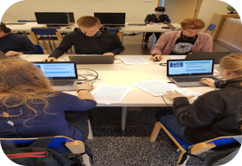
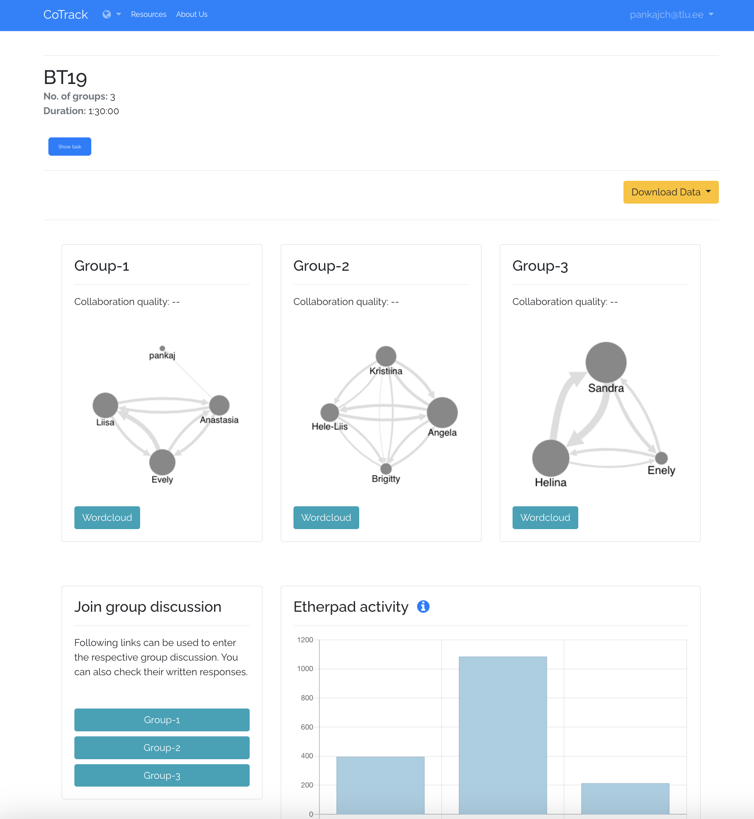
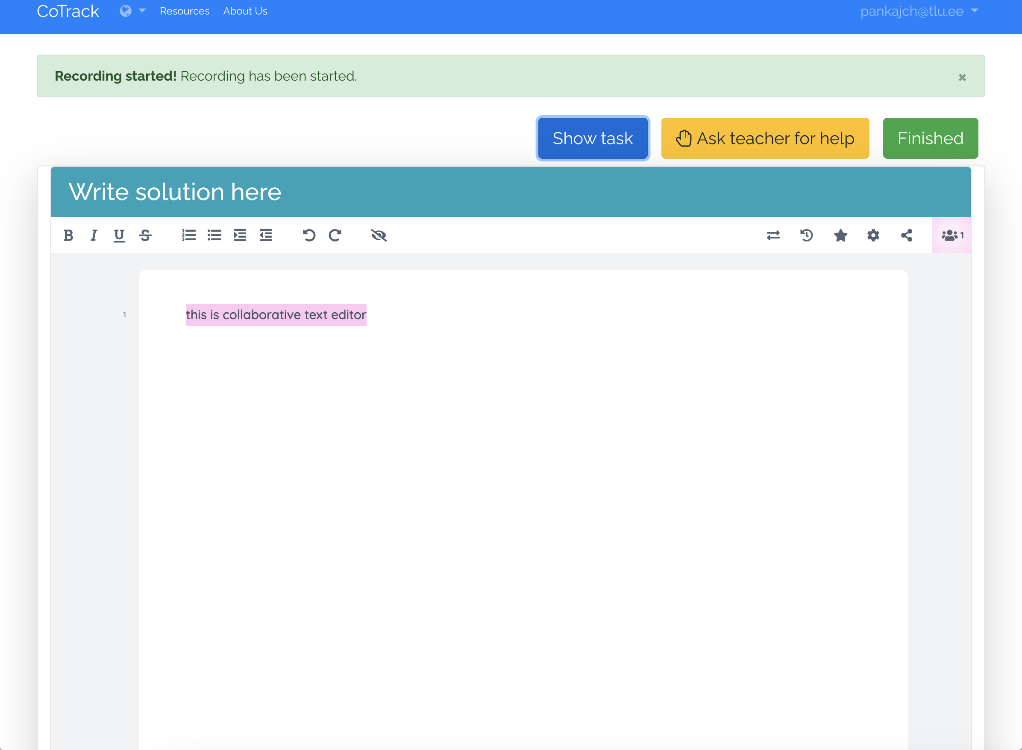
CoTrack
Multimodal data features
Collaborative writing space
Real-time dashboard

Slide 10
Purpose
CoTrack used for monitoring group activity
Users
1 Teacher 24 Students
Usability Evaluation
System Usability Scale
1 Teacher
To illustrate examples of (MM)LA tools
2 Researchers
To collect multimodal data for research (e.g., socially shared regulation of learning)
…
…
+
…
7

Slide 11
USABILITY RESULTS
74.4
77.5
47.5
STUDENTS
RESEARCHERS
TEACHER-2
N = 24
N = 2
unacceptable
marginal
acceptable
0
50
70
100

Slide 12
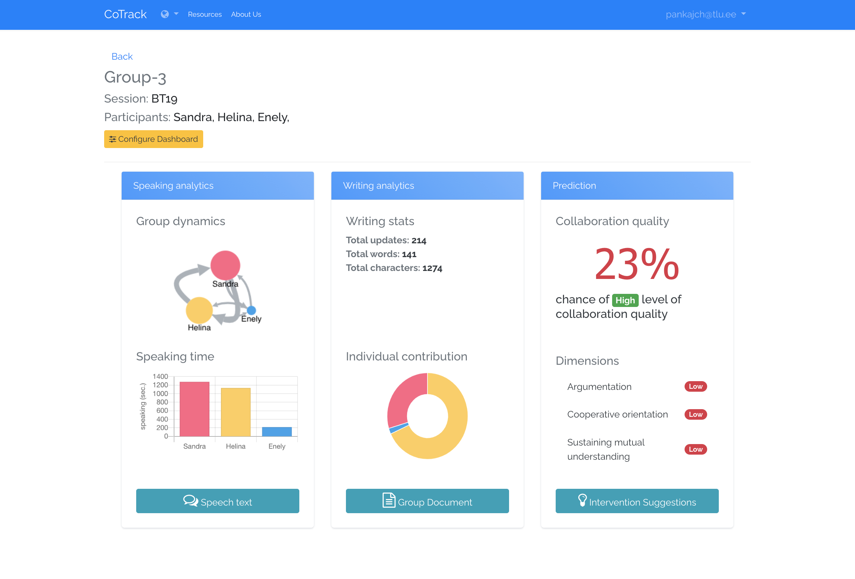
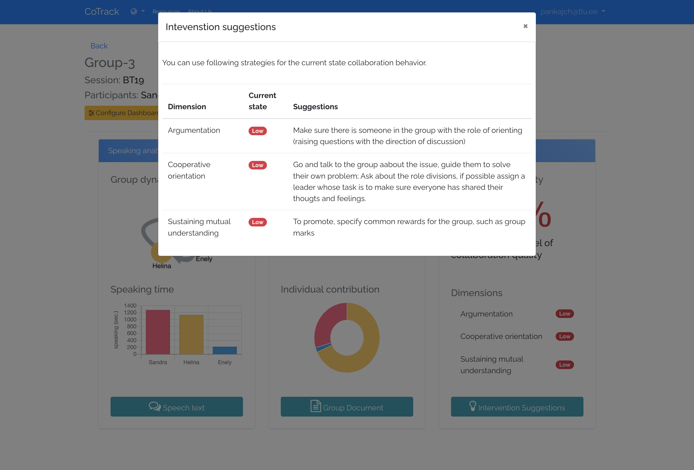
Best Demo Award LAK23
https://www.cotrack.website
6
58
600
Researchers
Teachers
Students
5

Slide 13
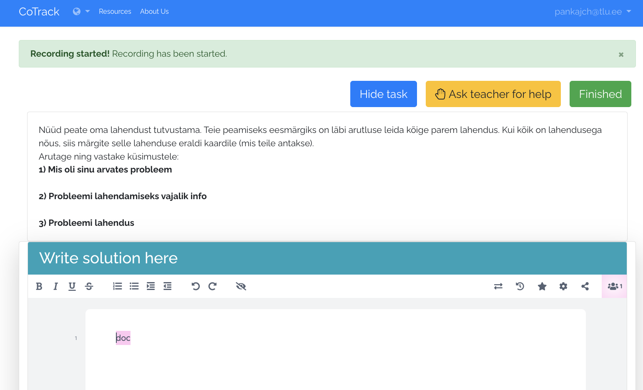
MINIMAL RELIANCE ON USERS
Minimise dependency on users for any data collection related tasks
GUIDELINES
6

Slide 14
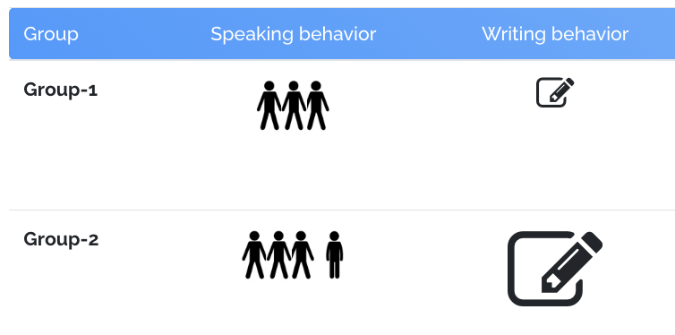
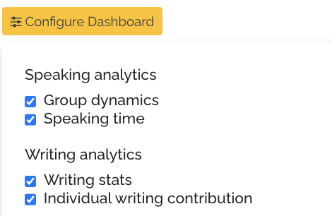
Abstract Visualization
Replace numerical values with abstract representation
MINIMAL RELIANCE ON USERS
Minimise dependency on users for any data collection related tasks
GUIDELINES
6
6

Slide 15
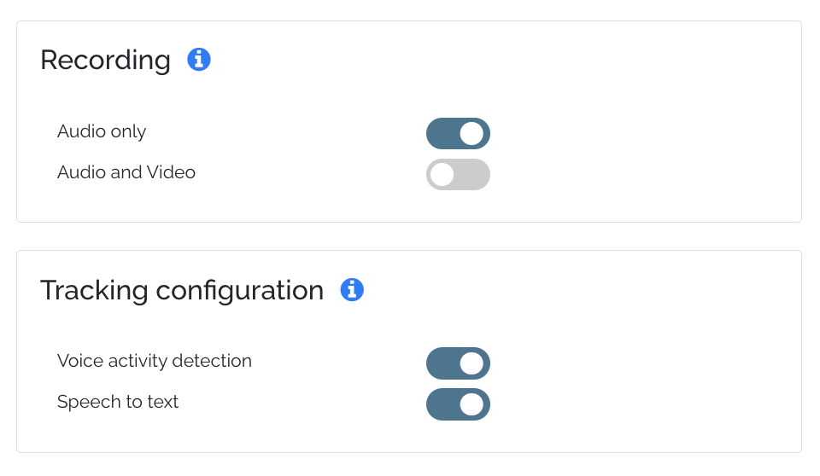
Real-time feature computation
Extract features in real-time to avoid recording of multimodal data (ethical and privacy concerns)
Abstract Visualization
Replace numerical values with abstract representation
GUIDELINES
6
6

Slide 16
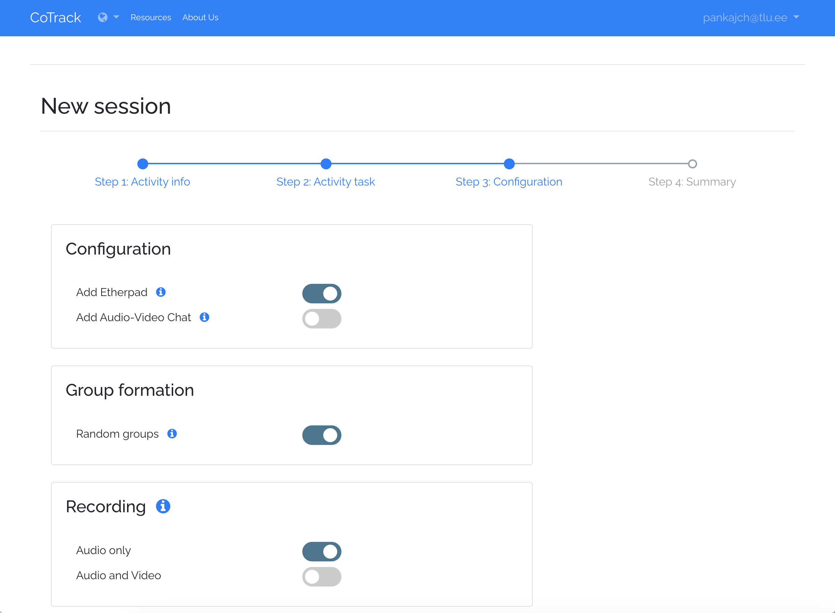
Automation of technical configuration
Allow an easy-to-user interface to customize the data collection process
Real-time feature computation
Extract features in real-time to avoid recording of multimodal data (ethical and privacy concerns)
GUIDELINES
6

Slide 17
Automation of technical configuration
Allow an easy-to-user interface to customize the data collection process
GUIDELINES
6

Slide 18
Conclusion
How to design and develop an easy to use MMLA systems for multimodal data collection and visualization of students’ activities during CSCL activities?
1
Human-centered design
Integration of ML models for estimating collaboration quality
1
2
Design guidelines (e.g., abstract visualization)
9

Slide 19
Thank You
Pankaj Chejara
pankajch@tlu.ee

Slide 20
References
Martinez-Maldonado, R., Gašević, D., Echeverria, V., Fernandez Nieto, G., Swiecki, Z., & Buckingham Shum, S. (2021). What Do You Mean by Collaboration Analytics? A Conceptual Model. Journal of Learning Analytics, 8(1), 126–153. https://doi.org/10.18608/jla.2021.7227
Martinez-Maldonado, R., Echeverria, V., Fernandez-Nieto, G., Yan, L., Zhao, L., Alfredo, R., ... & Gašević, D. (2023). Lessons learnt from a multimodal learning analytics deployment in-the-wild. ACM Transactions on Computer-Human Interaction, 31(1), 1-41.
Schneider, J., Di Mitri, D., Limbu, B., & Drachsler, H. (2018). Multimodal learning hub: A tool for capturing customizable multimodal learning experiences. In Lifelong Technology-Enhanced Learning: 13th European Conference on Technology Enhanced Learning, EC-TEL 2018, Leeds, UK, September 3-5, 2018, Proceedings 13 (pp. 45-58). Springer International Publishing.
Wagner, J., Lingenfelser, F., Baur, T., Damian, I., Kistler, F., & André, E. (2013, October). The social signal interpretation (SSI) framework: multimodal signal processing and recognition in real-time. In Proceedings of the 21st ACM international conference on Multimedia (pp. 831-834).
Schneider, B., Hassan, J., & Sung, G. (2022). Augmenting social science research with multimodal data collection: the EZ-MMLA Toolkit. Sensors, 22(2), 568.
Kothe, C., Shirazi, S. Y., Stenner, T., Medine, D., Boulay, C., Crivich, M. I., ... & Makeig, S. (2024). The Lab Streaming Layer for Synchronized Multimodal Recording. bioRxiv, 2024-02.

Slide 21
VISUALIZATION MODULE
PREDICTION MODULE
STORAGE
MODULE
PREPROCESSING MODULE
VOICE ACTIVITY DETECTION
DATABASE
SPEECH TO TEXT
LOG PROCESSOR
https://www.cotrack.website
FETCHER
MODULE
REST API
CLIENT-SERVER INTERFACE
MULTIMEDIA FILES
REST API
ETHERPAD

Slide 22
Minimal reliance on participants for data collection-related instructions
1
Design Guidelines
2
Automation of technological configuration
3
Real-time feature computation
4
Multimodal visualization guidelines
6

Slide 23
MINIMAL RELIANCE ON USERS
Minimise the dependency on users for any data collection related tasks
GUIDELINES
6

Slide 24
Abstract Visualization
Replace numerical values with abstract representation
GUIDELINES
6

Slide 25
Real-time feature computation
Extract features in real-time to avoid recording of multimodal data (ethical and privacy concerns)
GUIDELINES
6

Slide 26
Automation of technical configuration
Allow an easy-to-user interface to customize the data collection process
GUIDELINES
6

Slide 27
unacceptable
marginal
acceptable
0
50
70
100
SUS scale

Slide 28
74.4 %
74.4%

Slide 29
74.4%

Slide 30
74.4%

Slide 31
77.5%

Slide 32
47.5%

