Slide 1
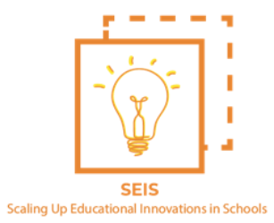
Building an automated system to detect collaboration quality using multimodal learning analytics
Pankaj Chejara
Center of Education Technology
Tallinn University
Estonia
pankajch@tlu.ee

Slide 2
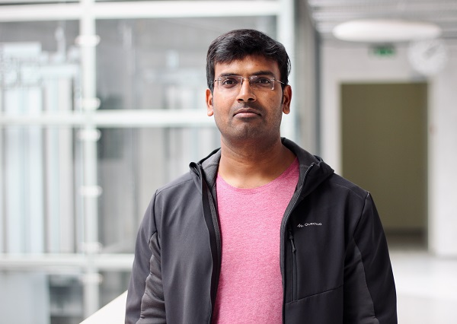
Introduction
Pankaj Chejara
PhD Scholar (Multimodal Learning Analytics)
Tallinn University, Estonia
Masters (Comp. Eng.)
Masters (Comp. app.)
INDIA
Bachelor (Mathematics)

Slide 3
Context
Collaborative learning in Classroom settings
Students do not learn this skill if left alone in collaborative activity (Stover & Holland, 2018)
Stover, S., & Holland, C. (2018). Student Resistance to Collaborative Learning. International Journal for the Scholarship of Teaching and Learning, 12(2). https://doi.org/10.20429/ijsotl.2018.120208
Image: https://www.aver.com/AVerExpert/7-edtech-tools-every-smart-classroom-needs

Slide 4
Context
Collaborative learning in Classroom settings
It may be difficult for teachers to know for each group in the classroom “what is going on in the group?” (Alavi et al. 2009; Lui & Nesbit, 2019).
Students do not learn this skill if left alone in collaborative activity (Stover & Holland, 2018)
Liu, A. L., & Nesbit, J. C. (2020). Dashboards for computer-supported collaborative learning. In Intelligent Systems Reference Library (Vol. 158). Springer International Publishing. https://doi.org/10.1007/978-3-030-13743-4_9

Slide 5
Context
Collaboration quality: Multidimensional construct
Rummel, N., Deiglmayr, A., Spada, H., Kahrimanis, G., & Avouris, N. (2011). Analyzing collaborative interactions across domains and settings: An adaptable rating scheme. In Analyzing interactions in CSCL (pp. 367-390). Springer, Boston, MA.

Slide 6
There is a need of a system which can support teachers with monitoring and interventions during collaborative activities in classroom.

Slide 7
Related work
Learning analytics for building a monitoring system for collaboration
Digital Space
Students interaction with digital technology
Digital Traces
Learning Analytics

Slide 8
Related work
Learning analytics for building a monitoring system for collaboration [limitation]
Digital Space
Physical Space
Students interaction with digital technology
Students face to face interaction
?
Digital Traces
Learning Analytics

Slide 9
Related work
Multimodal Learning analytics for building monitoring system for collaboration
Digital Space
Physical Space
Students interaction with digital technology
Students face to face interaction
Digital Traces
Multimodal Learning Analytics

Slide 10
Research objective
Main research goal of my PhD
To build and assess MMLA technological support for estimation of collaboration quality and its various dimensions in small groups in classroom collaborative learning.
Intervention/Support
Multimodal data
Collaborative activity
MMLA System
Monitoring & Guidance
Teacher

Slide 11
Investigating the feasibility of estimating collaboration quality dimensions in classroom settings
1

Slide 12
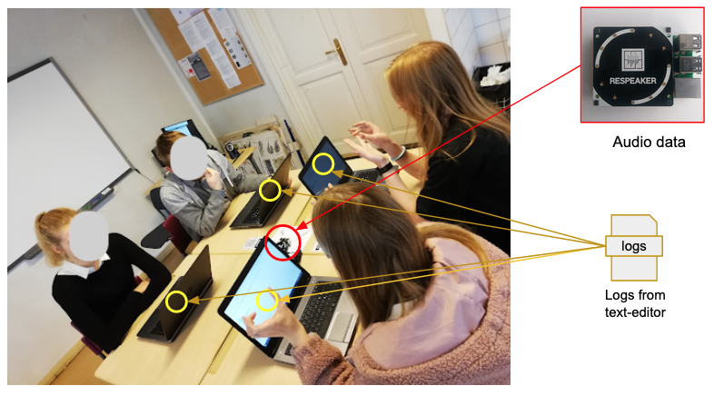
First Research Study
Context: Estonian high school students
Data: audio and logs
Group-size: 3,4
Features: speaking time, number of characters added or deleted
Annotation: Using rating handbook from Rummel et al., 2015
Chejara, P., Prieto, L. P., Ruiz-Calleja, A., Rodríguez-Triana, M. J., Shankar, S. K., & Kasepalu, R. (2020, September). Quantifying collaboration quality in face-to-face classroom settings using mmla. In International Conference on Collaboration Technologies and Social Computing (pp. 159-166). Springer, Cham.

Slide 13
First Research Study
The model showed good performance but due to small dataset, the generalizability of the model was in question.
Context: Estonian high school students
Data: audio and logs
Group-size: 3,4
Features: speaking time, number of characters added or deleted
Annotation: Using rating handbook from Rummel et al., 2015
Model development
Model evaluation
Publication
Model use in practice ??
Research gap: Lack of standard practice on systematic evaluation of models in Multimodal learning analytics

Slide 14
First Research Contribution
EFAR-MMLA: An evaluation framework for assessing and reporting generalizability of machine learning models in MMLA
Guidelines for assessing models on generalizability levels related to education
Guidelines for reporting model performance
Context
Group
Instance
Generalizability levels
Chejara, P., Prieto, L. P., Ruiz-Calleja, A., Rodríguez-Triana, M. J., Shankar, S. K., & Kasepalu, R. (2021). EFAR-MMLA: An Evaluation Framework to Assess and Report Generalizability of Machine Learning Models in MMLA. Sensors, 21(8), 2863.

Slide 15
COVID-19
Rethink focus of your PhD

Slide 16
A web-based application to conduct collaborative learning activities with multimodal data collection and monitoring functionalities
https://www.cotrack.website

Slide 17
Developing generalizable machine learning models for collaboration quality dimensions
2

Slide 18
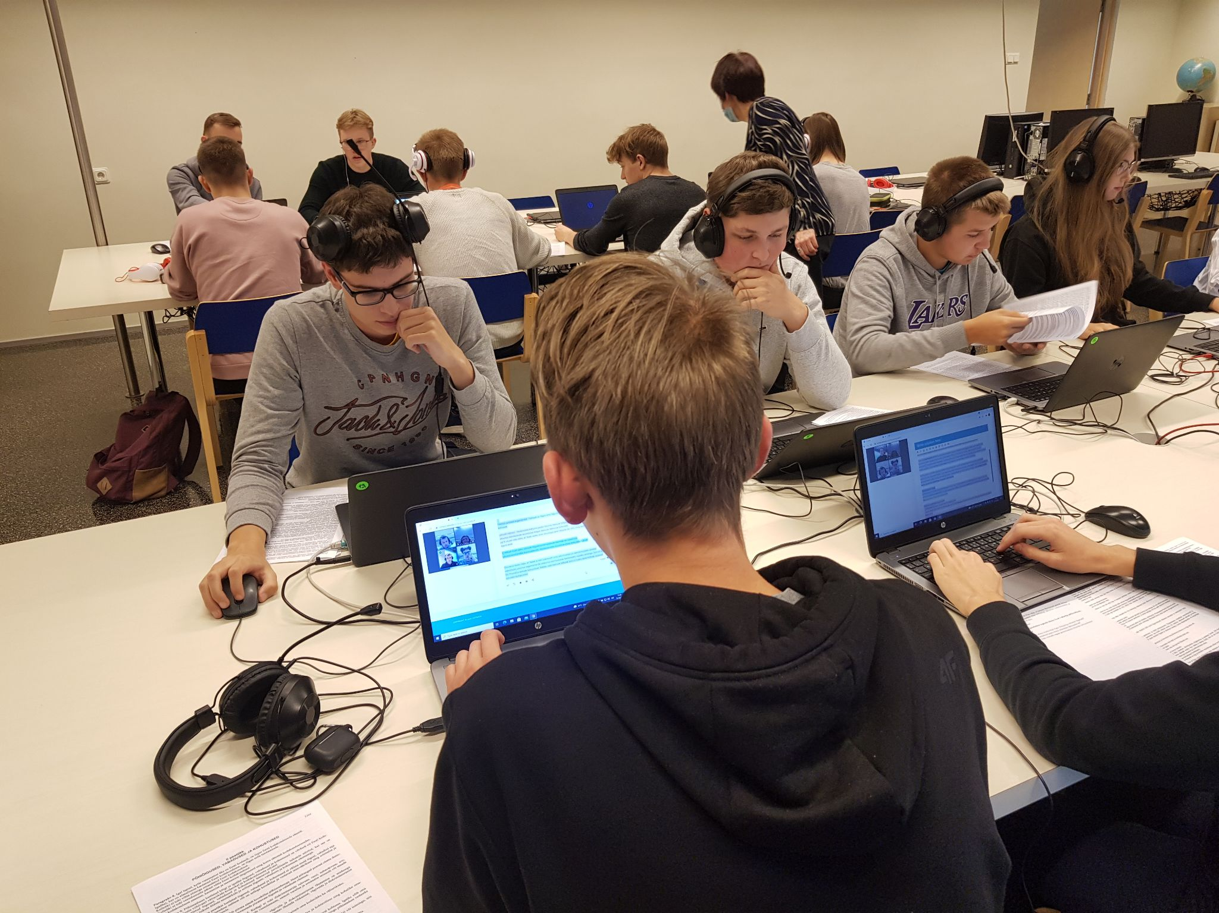
Second Research Study
7 Different types of activity
11 different learning contexts
72 students
~1200 minutes of video recordings
Context: Estonian high school students
Data: audio and logs
Group-size: 3,4
Features: speaking time, turk-taking, number of characters added or deleted
Annotation: Using rating handbook from Rummel et al., 2015

Slide 19
Second Research Study
No success in building generalizable models for collaboration quality and its various dimensions using widely used model development process in MMLA.
Context: Estonian high school students
Data: audio and logs
Group-size: 3,4
Features: speaking time, turn-taking, number of characters added or deleted
Annotation: Using rating handbook from Rummel et al., 2015
Research gap: Lack of MMLA research on using temporal aspect for modeling collaboration quality

Slide 20
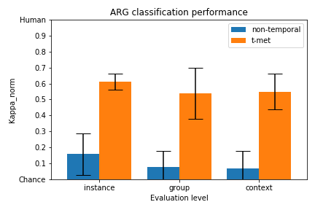
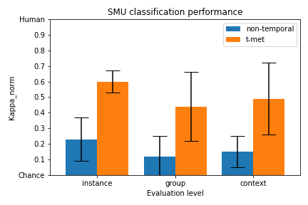
Second Research Contribution
Argumentation classification model
T-MET: A time-aware method for building collaboration models using multimodal learning analytics
Utilizes temporal aspect of collaboration process.
Improves model’s performance significantly.
Sustaining mutual understanding classification model
Planning to submit in this month

Slide 21
Building a monitoring and guidance system based on developed models to support teachers
3

Slide 22
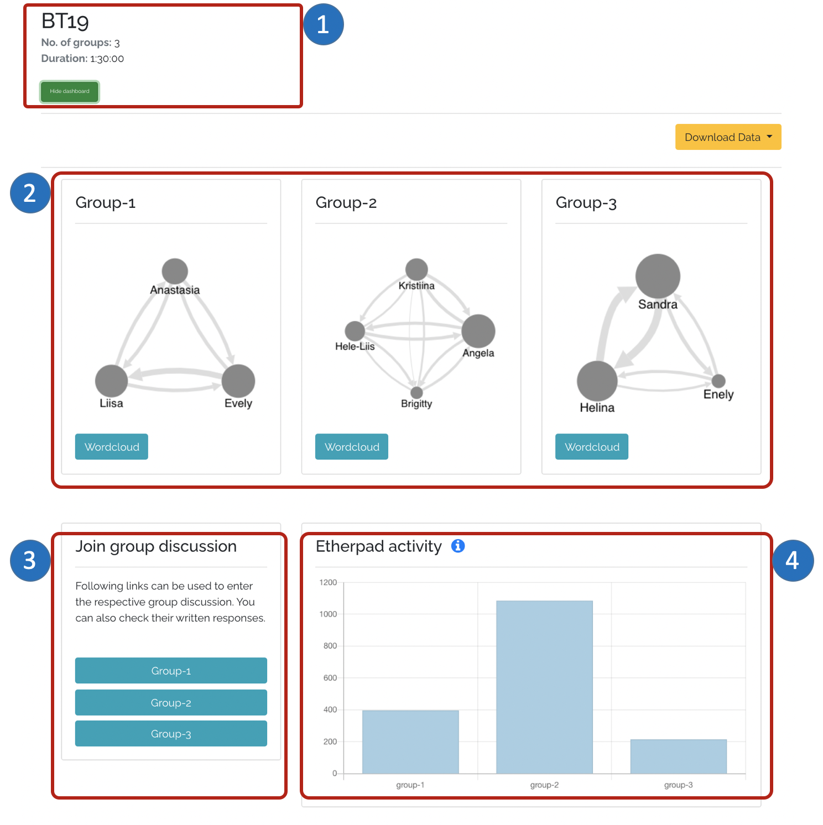
Third Research Study
Monitoring functionality
Activity details
Participants: Estonian high school teachers
Data: survey
Evaluation aspects: Usability, ease of use, behavioral intention for adoption
Social dynamics
Controls to join particular group discussion/seeing their solution
Group activity in terms of writing updates

Slide 23
Third Research Study
Guidance functionality
Integration of developed models in CoTrack for classifying collaboration quality dimensions.
Participants: Estonian high school teachers
Data: survey
Evaluation aspects: Usability, ease of use, behavioral intention for adoption
+ AI
Integration of suggestions from learning sciences on intervention strategies.
Collaboration intervention model
Kasepalu, Reet; Prieto, Luis P.; Ley, Tobias; Chejara, Pankaj (2022). Teacher Artificial Intelligence-Supported Pedagogical Actions in Collaborative Learning Coregulation: A Wizard-of-Oz Study. Frontiers in Education, 7, ARTN 736194. DOI: 10.3389/feduc.2022.736194.

Slide 24
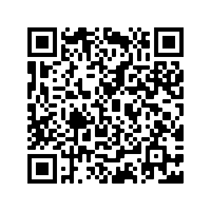
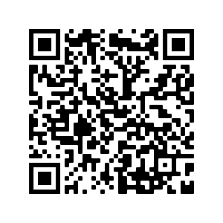
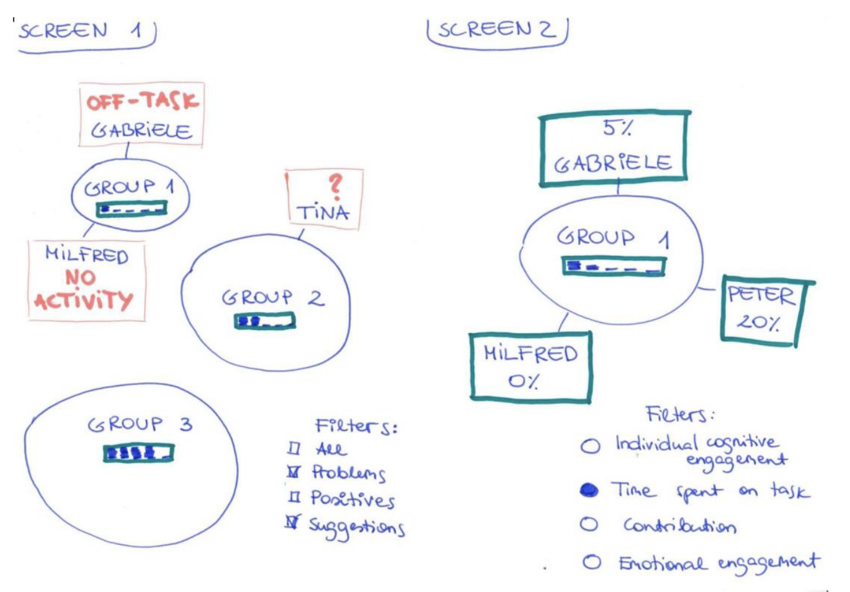
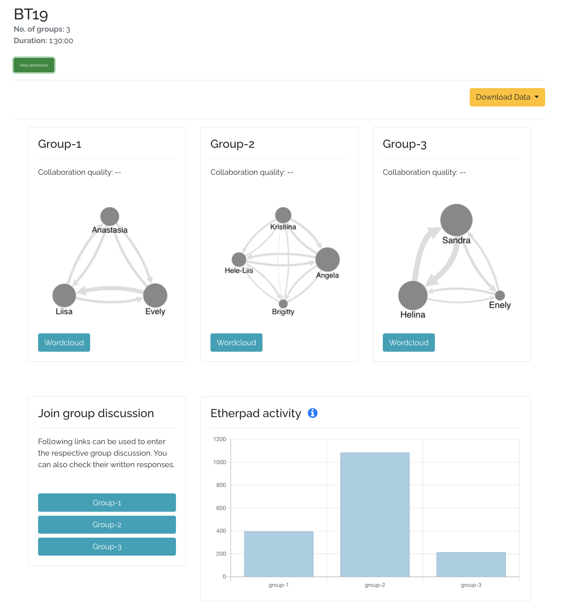
Co-Designing a Multimodal Dashboard for Collaborative Analytics
Pankaj Chejara, Reet Kasepalu, Adolfo Ruiz-Calleja, María Jesús Rodríguez-Triana, Luis P. Prieto
Tallinn University, Estonia
Background
Methods
Key findings
Dashboards built on traditional log-based learning analytics only offers partial view of (face-to-face) collaboration process.
Paper prototype development
Preference of abstract representations over quantitative measure.
8 in-service teachers
Refer for more details
Traffic light presentation of collaboration quality.
Multimodal Learning Analytics (MMLA) can offer a more holistic understanding of collaborative learning activities.
Pen for presenting writing contribution, size of pen representing amount of contribution.
Interview
Freedom to choose a single analytics rather than having all analytics at the same time.
Paper prototype
Due to the inherent complexity of MMLA, the main challenge is ‘How to present multiple types of data (e.g., audio, logs) effectively to the teacher?’.
Interest for student’s individual contribution towards generated artefact
Workshop using software prototype
50 in-service teachers
Need of alert mechanism for detecting passive students.
Need for control over students’ learning space for better management.
Research introduction
Group activity
Design implications
Group artifact
Do not show all the data at the same time.
Software prototype
Allow teachers to choose analytics to show.
Group reflection
Prototype landing page
Workshop
Integrate abstract representation for detected learning behavior.
https://www.cotrack.website
The research presented in the paper has received partial funding from the European Union’s Horizon 2020 research and innovation programme under grant agreement No 856954.
Image: Freepic.com

Slide 25
Coming next
Thesis writing :-)

Slide 26
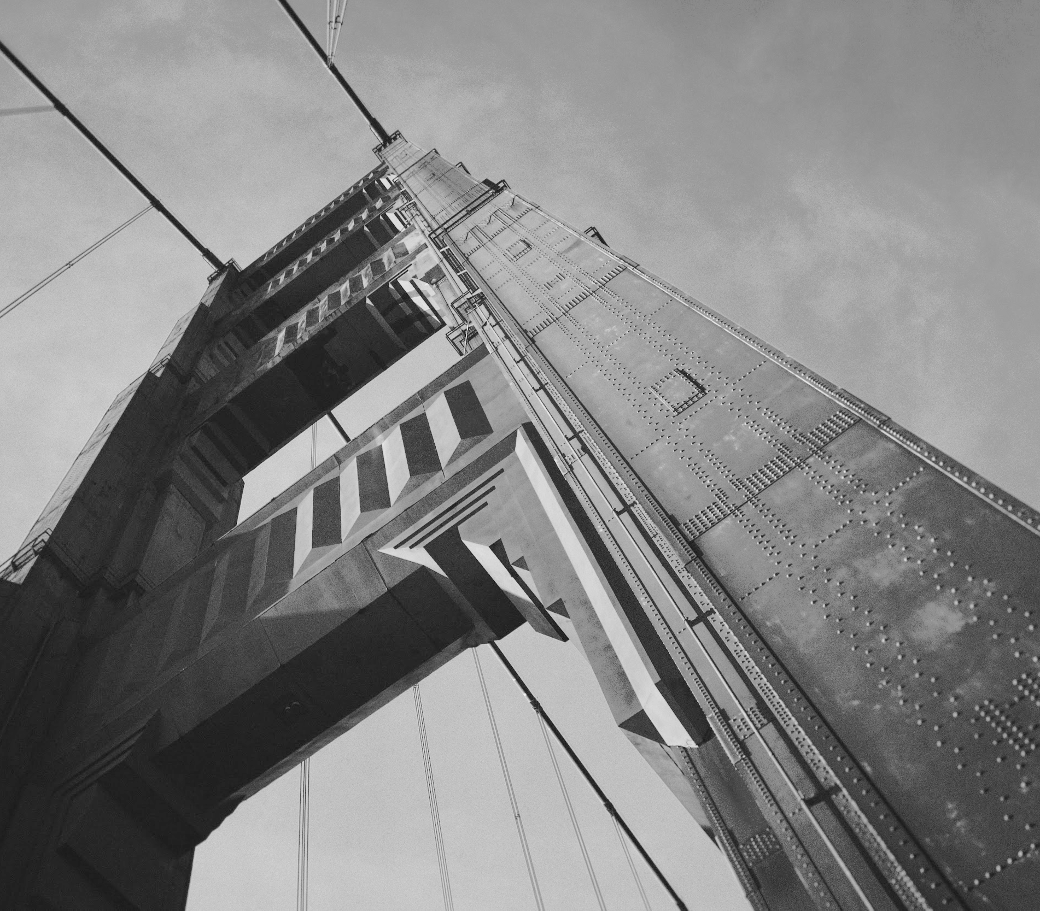
Thanks!
Contact us:
Pankaj Chejara
School of digital technologies
Tallinn University, Estonia
pankajch@tlu.ee
www.pankajchejara.website

